Slide 1
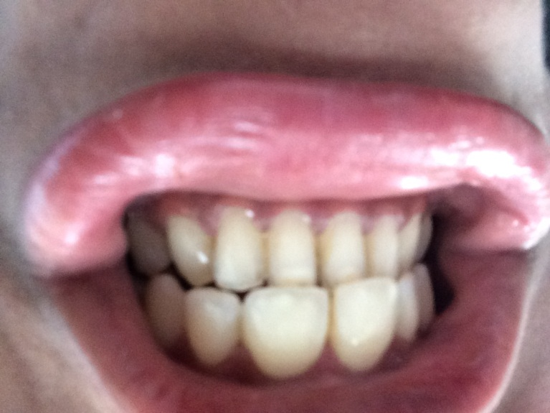
Current Status of the teeth
Smile required like below:

